Slide 1
Welcome to the presentation
Department of Computer Science & Engineering
Amrapali Group of Institute
Haldwani

Slide 2

Presentation on:
“ TRAVELORE – BOOK YOUR TRIP ”

Slide 3
What is Travelore ?
A Travelore is a website on the internet that is dedicated to travel. The purpose of website is established fact that Internet users are increasing today. Travelore contains only relevant packages and services that are a need of customer. Travelore has various packages which are basically services that Tour and Travels provides. Best part is, Travelore uses one account for providing all the package services for customers. Travelore is designed especially for customers who have no time for selection holidays to manage their holiday we developed the travelore.

Slide 4
Why Travelore ?
Customer has to approach various agencies to find details of places and to book tickets. This often requires a lot of time and effort. A customer may not get the desired information from these offices and often the customer may be misguided. It is tedious for a customer to plan a particular journey and have it executed properly. That’s why we need a platform like travelore where user can view and book packages online and for any query they can contact directly. .

Slide 5
Objective
To develop a web based application which includes packages at affordable prices
To provide best travelling services to the customers and travel agents.
To provide a search platform where a tourist can find their tour places according to their choices.
To promote responsible and interesting tourism so that people can enjoy their holidays at their favorable places.
To provide a better way to connect with various events.

Slide 6
Feasibility
Technical Feasible : Technically , This project is very Feasible because of use of current and latest techniques.
Financial Feasible : Financially , It is also very Feasible it made up in very low cost and will be free for all customer .
Operational Feasible : very easy to use

Slide 7
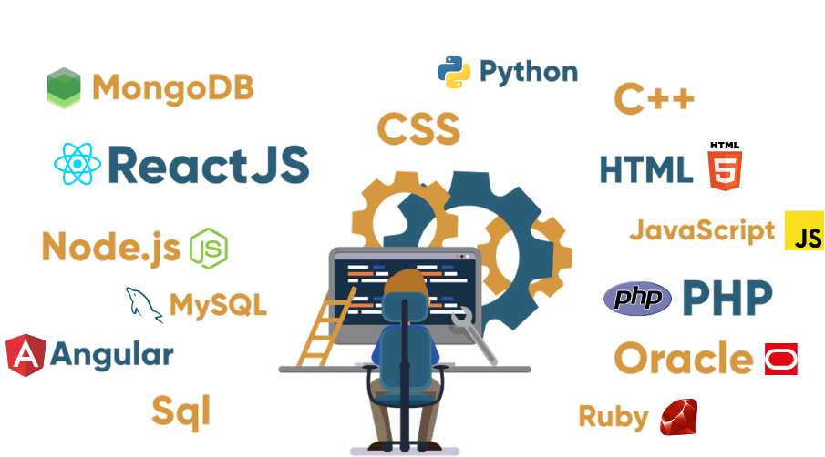
Technology Used
Front-end
HTML
CSS
Bootstrap 5
JavaScript
Back-end
Node Js
Express

Slide 8
Product Function
ADMINISTARTOR
Login
See Subscribers List
See Client details
See Contact us messages
See Client booking details
Logout
2. CLIENT / USER
Login
View and Book Packages
Fill Booking Form
Fill Contact Form
Can Subscribe
See Blogs and News
Logout

Slide 9
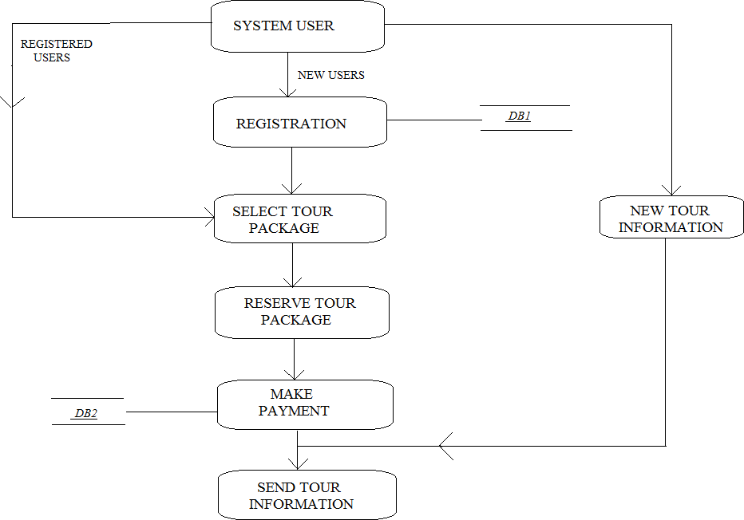
Data Flow Diagram

Slide 10
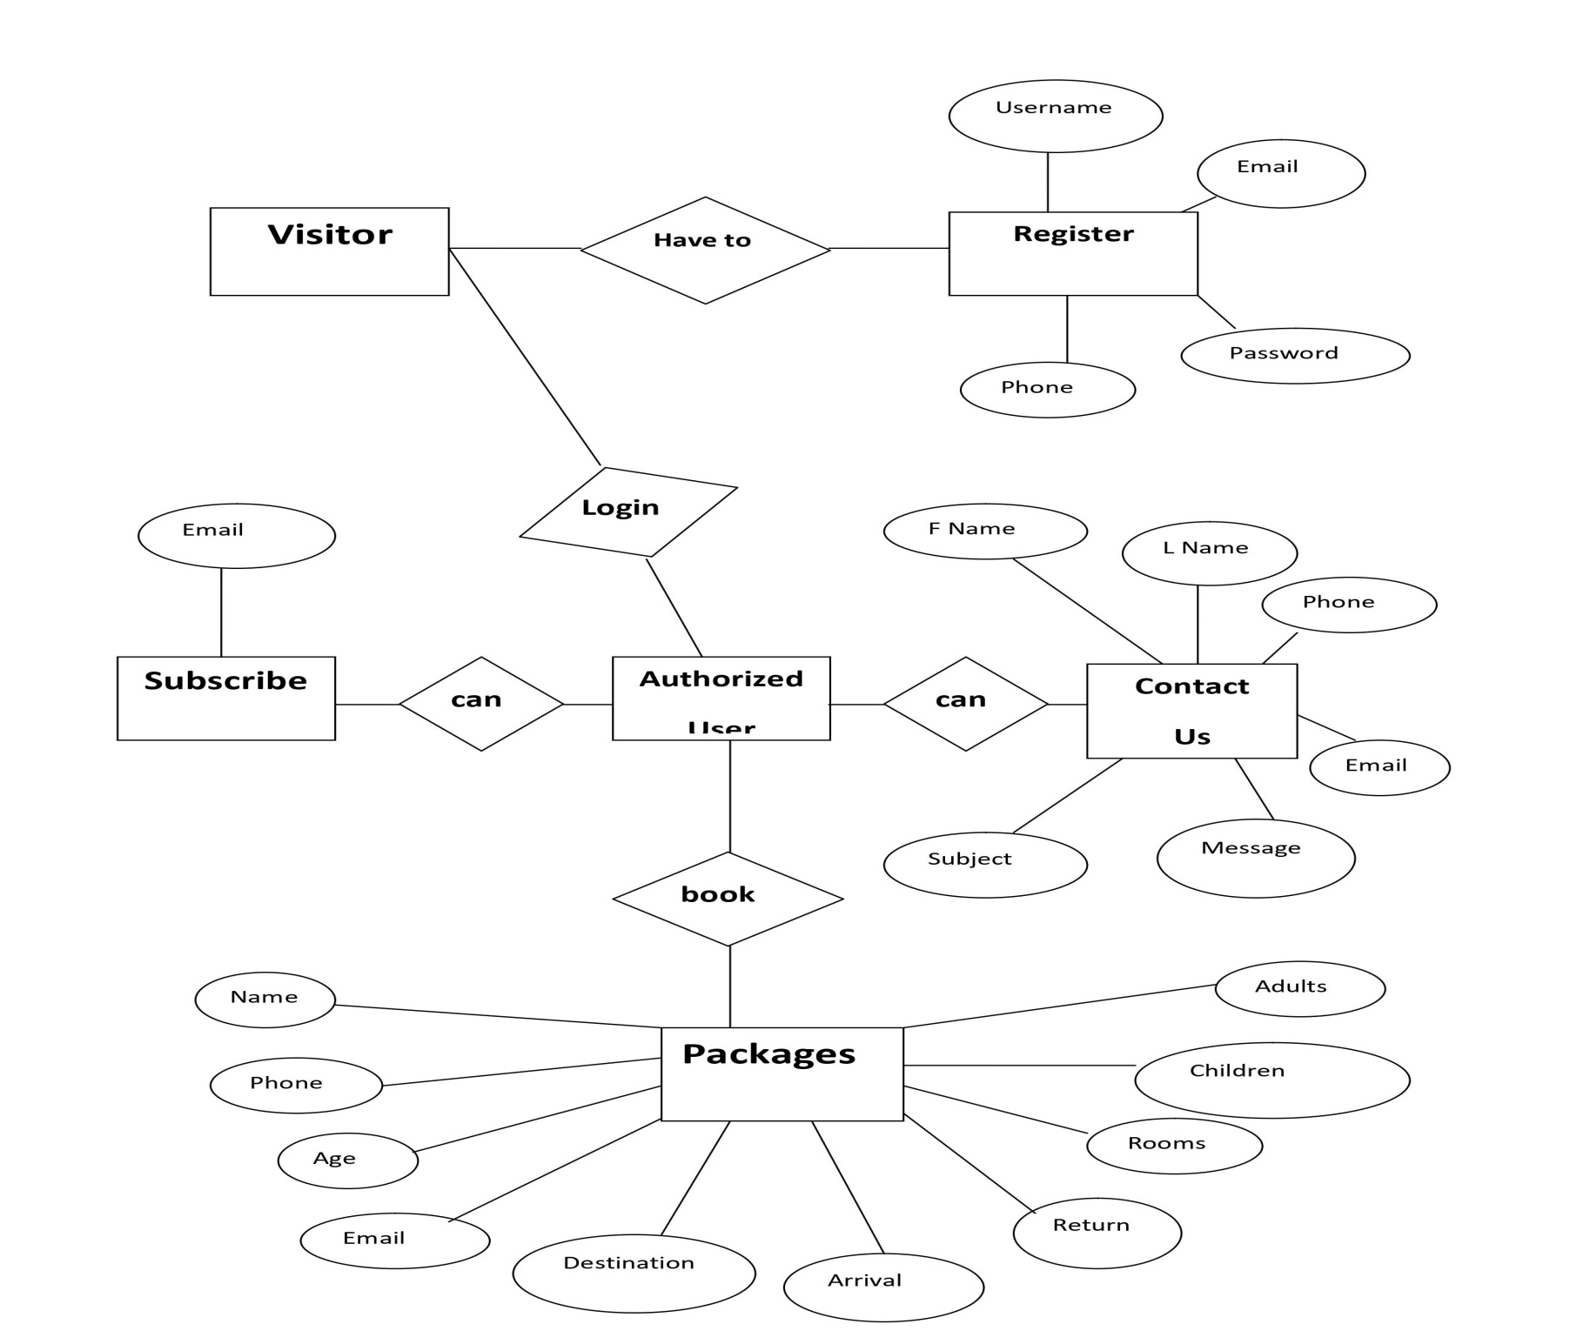
ER Diagram
An Entity Relationship (ER) Diagram is a type of flowchart that illustrates how “entities” such as people, objects or concepts relate to each other within a system.

Slide 11
Modules
Login/Logout Module
Customer Reservation Module
Token generation
User Authentication
Password Hashing
Tours Module
Contact us Module
Newsletter Module

Slide 12
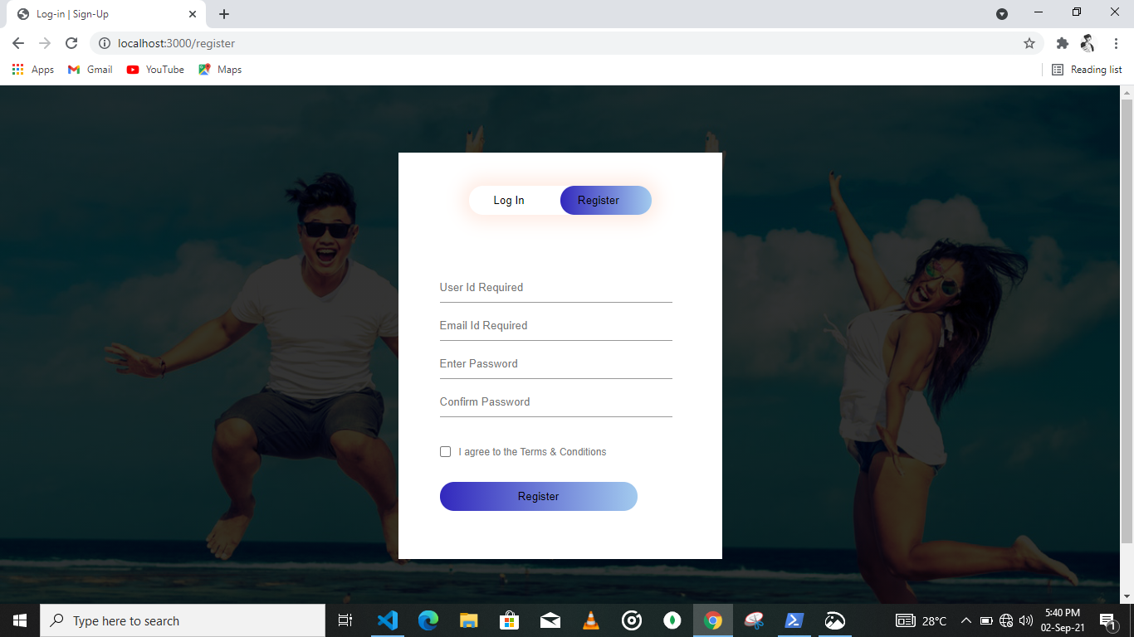
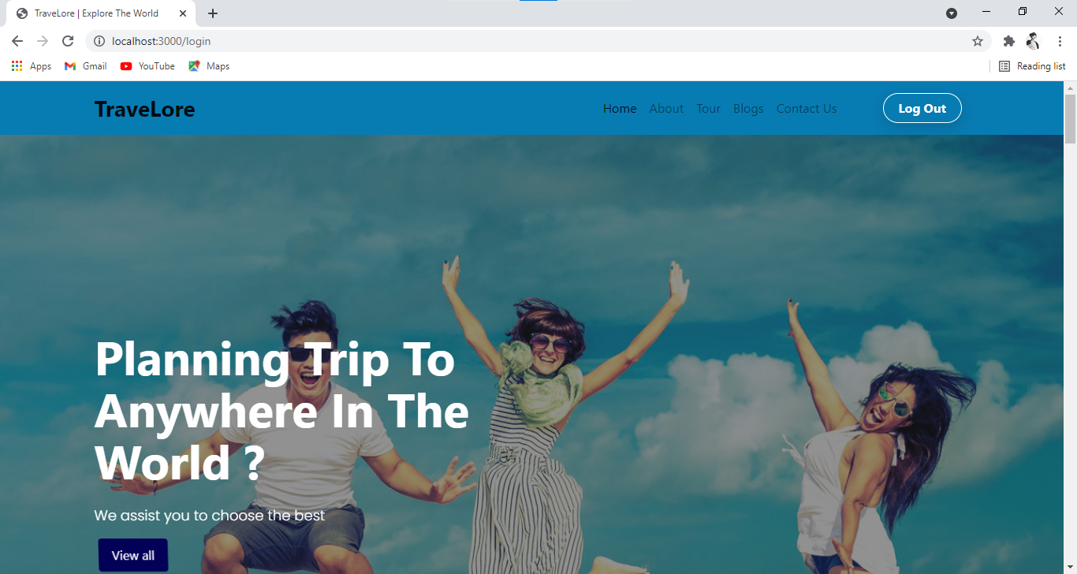
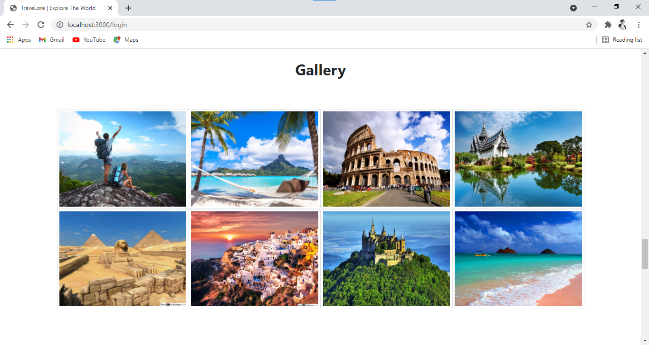
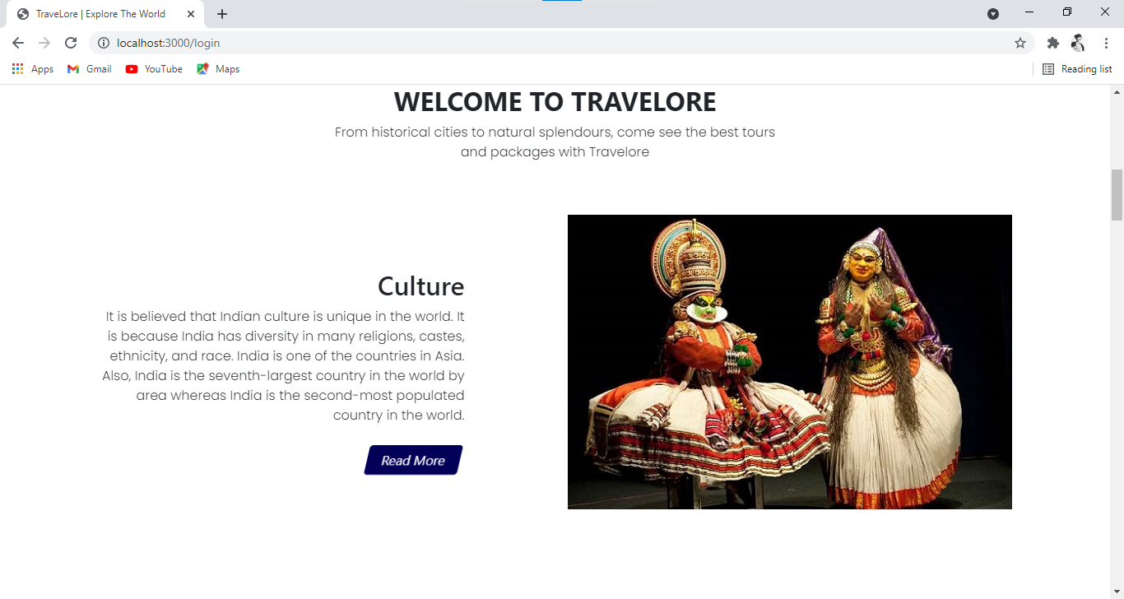
Snapshots

Slide 13
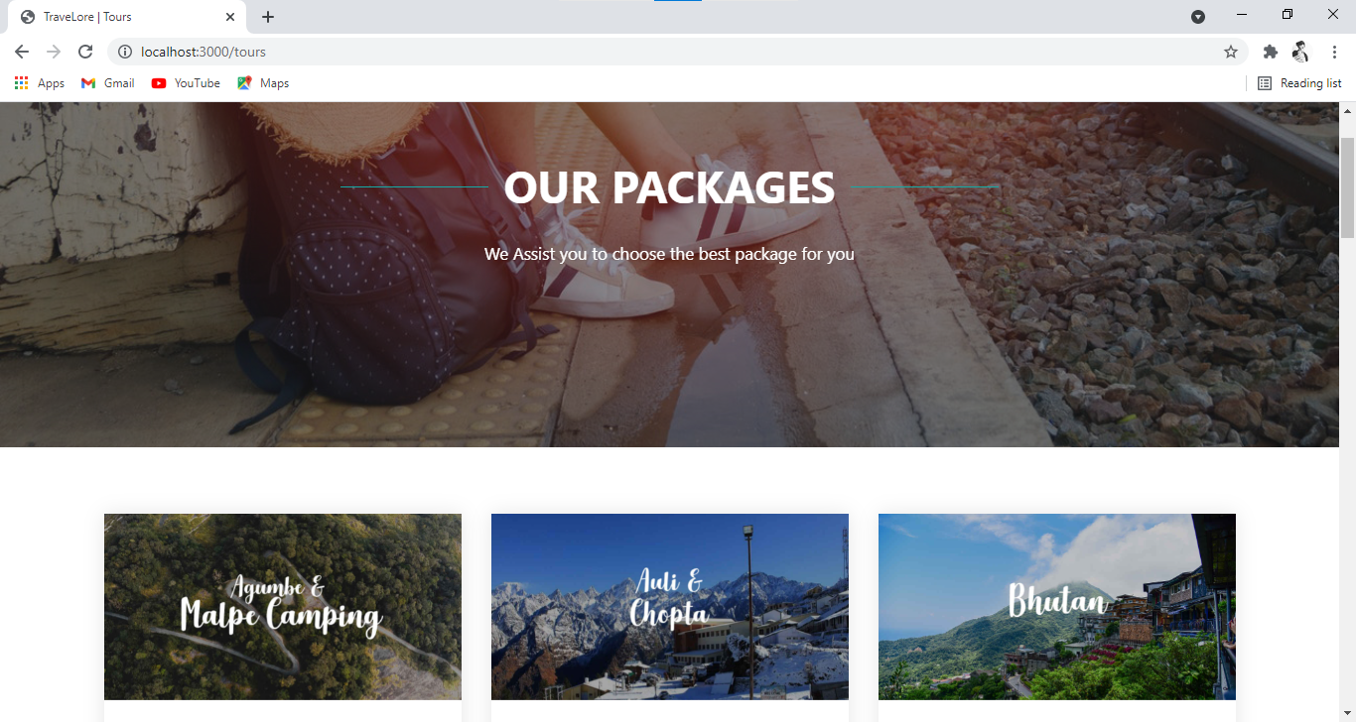
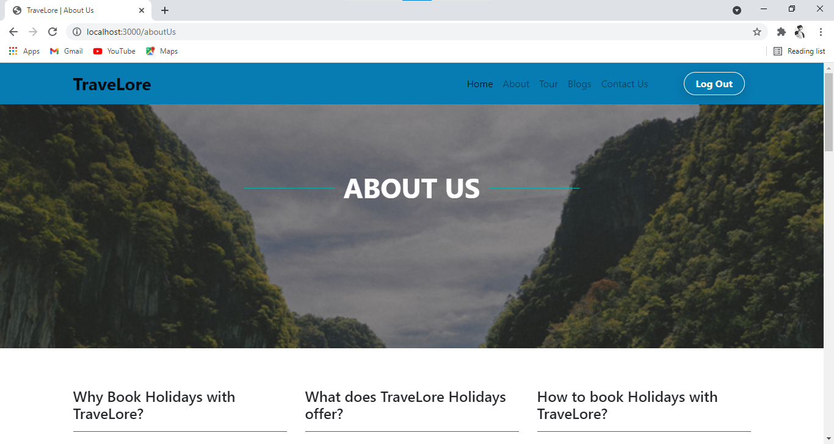
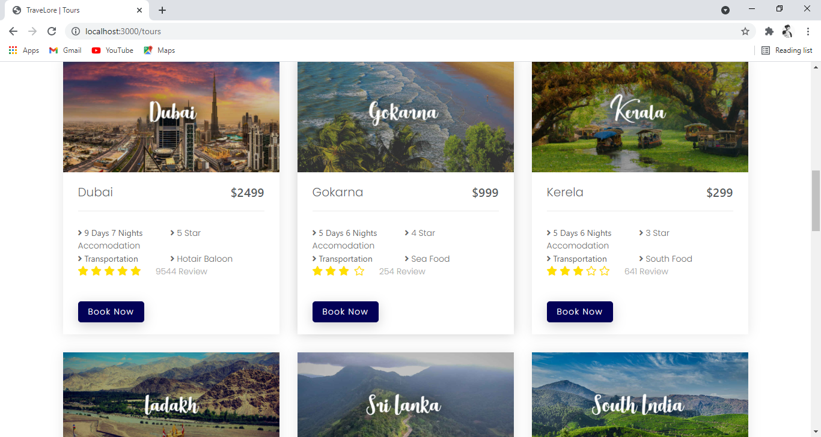
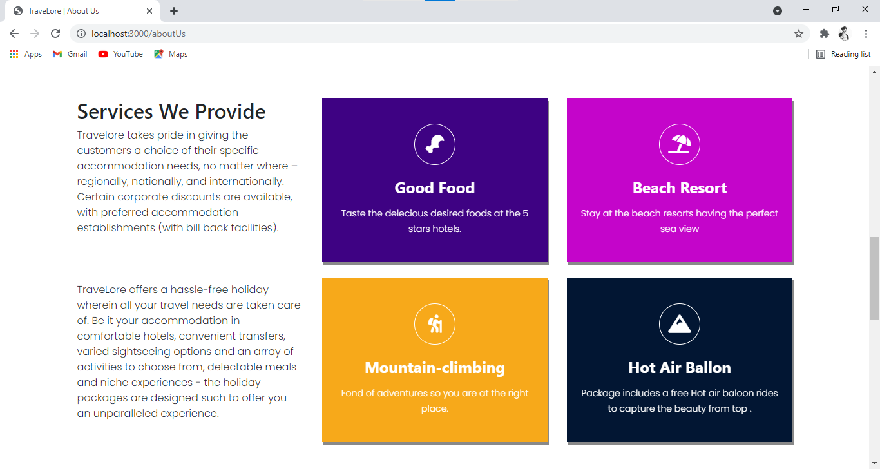

Slide 14
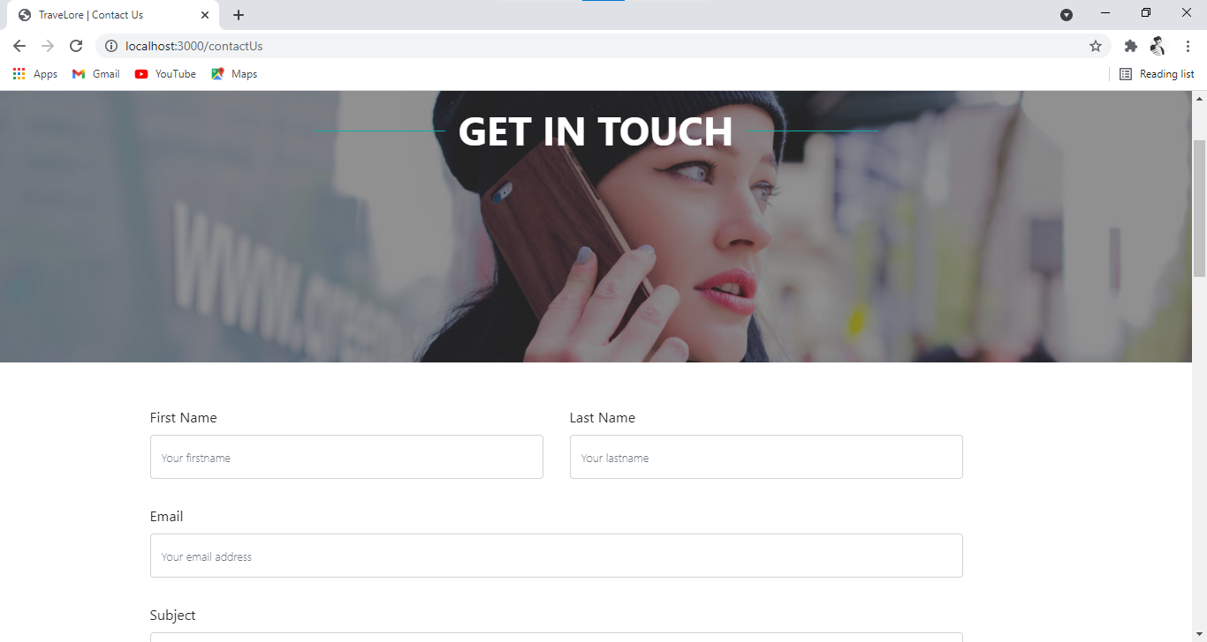
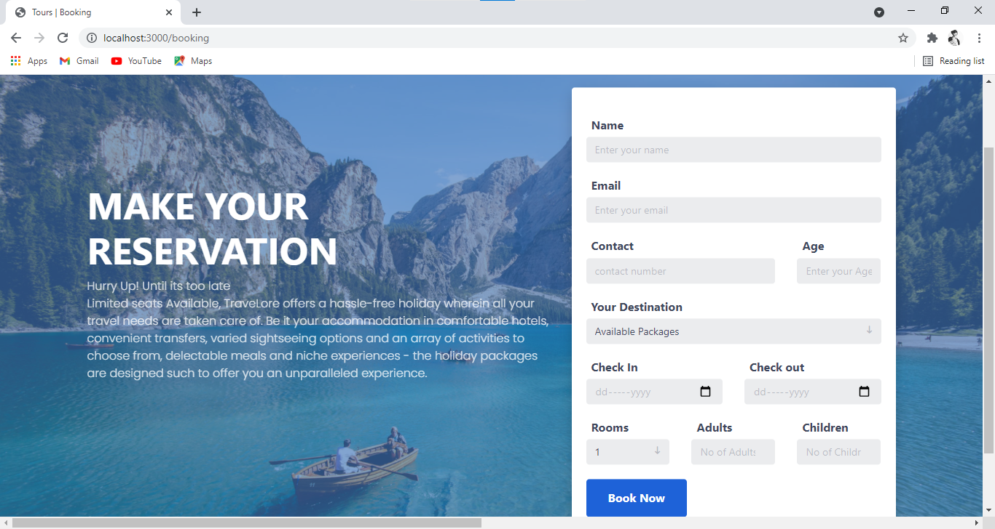
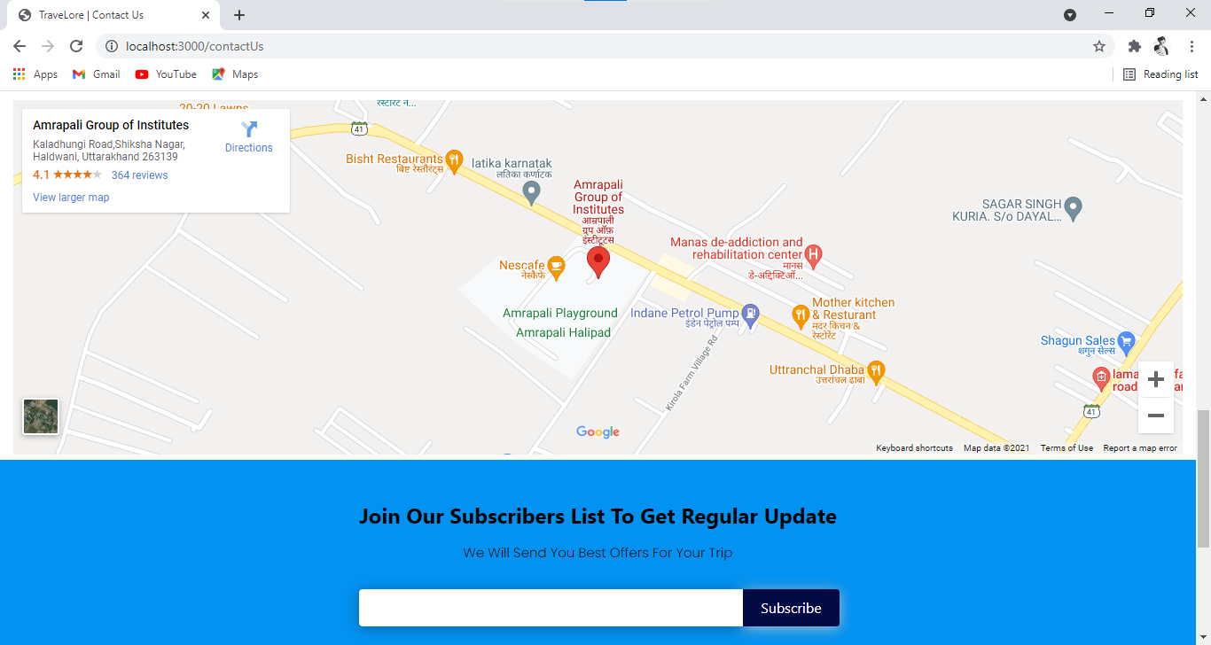
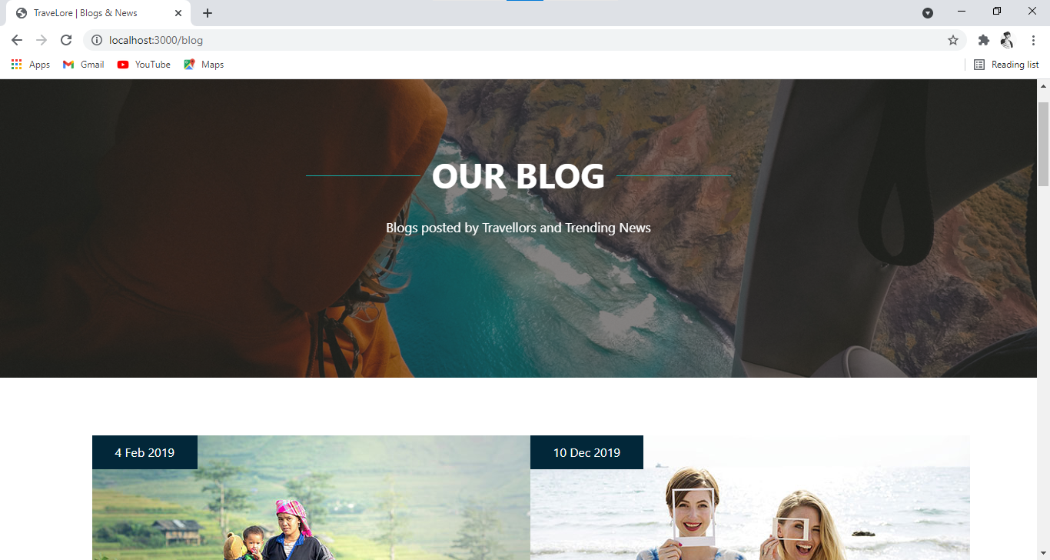

Slide 15
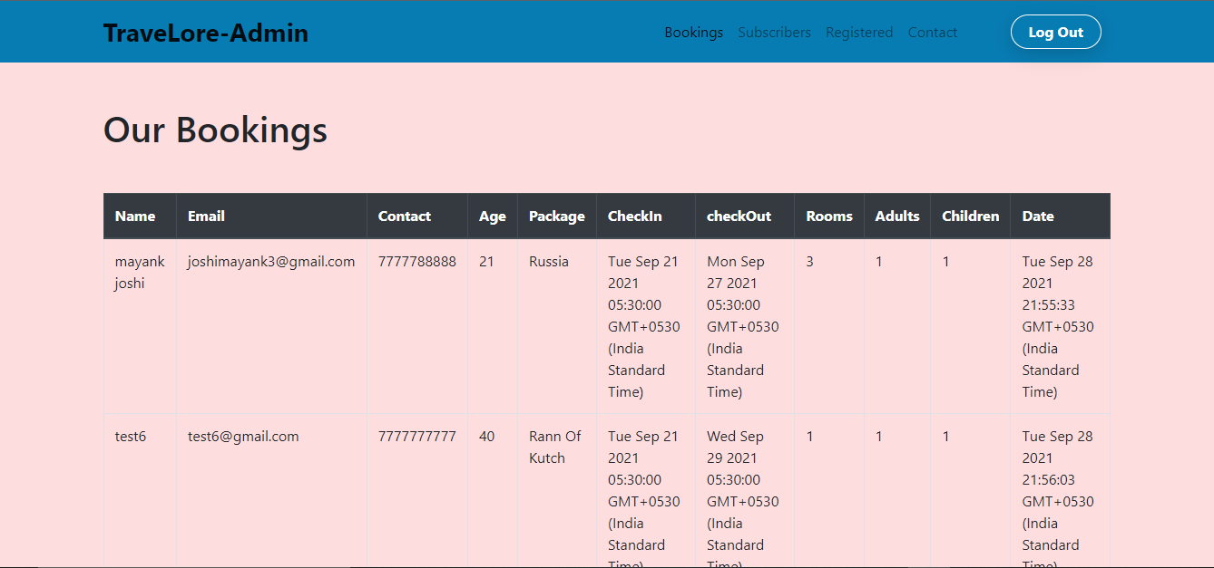
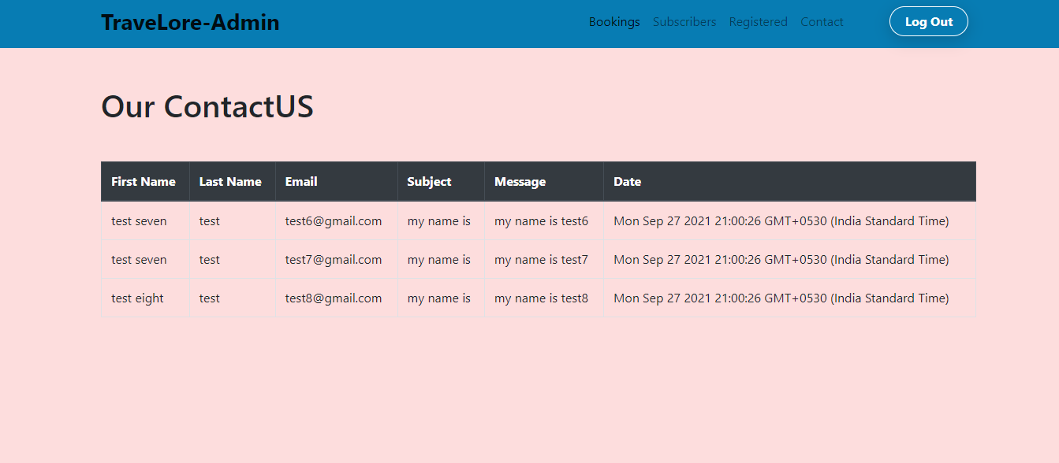
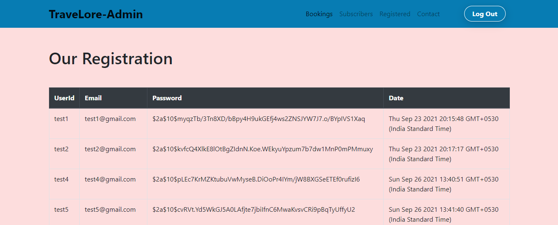
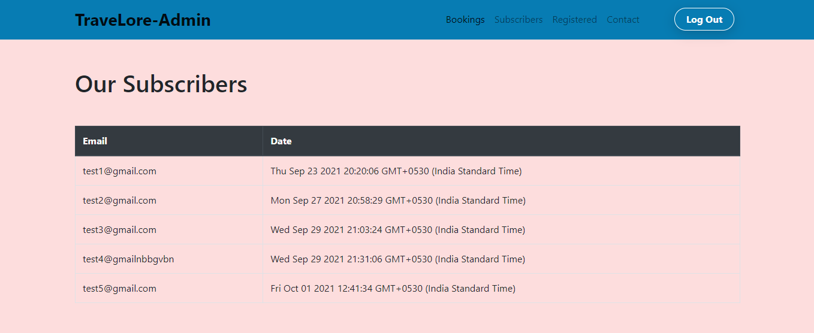

Slide 16
Future Scope
The project has very vast scope in the future. The project can be implemented on interact in future. Project can be also updated with the new features whenever the requirement of the same arises, as it is flexible in terms of expansion
Increase admin rights.
Separate module where client can update his/her personal details.
Separate module for viewing booking details.
Admin can manage and add venues, packages and update blog.
Make hotel and rental car reservations.
Easy payment methods (By credit card or Net banking or even Cash on Delivery).
A traveler can find everything related to travelling services under one roof by this website. The site will help to estimate the benefits and calculate the requirement very easily.

Slide 17
Conclusion
The “TRAVELORE” was successfully designed and is tested for accuracy and quality.
During this project we have accomplished all the objectives and this project meets the needs of the organization .The developed will be used in searching, retrieving and generating information for the concerned requests.

Slide 18
THANK YOU
By –Chetan Belwal

